Slide 1

ARpopUP
신한섭 이은지 한지현

Slide 2
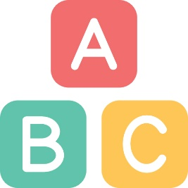

Index
Background
Introduction
Implementation
- platform
- screenshots
- process
Key features
Marketing plan

Slide 3
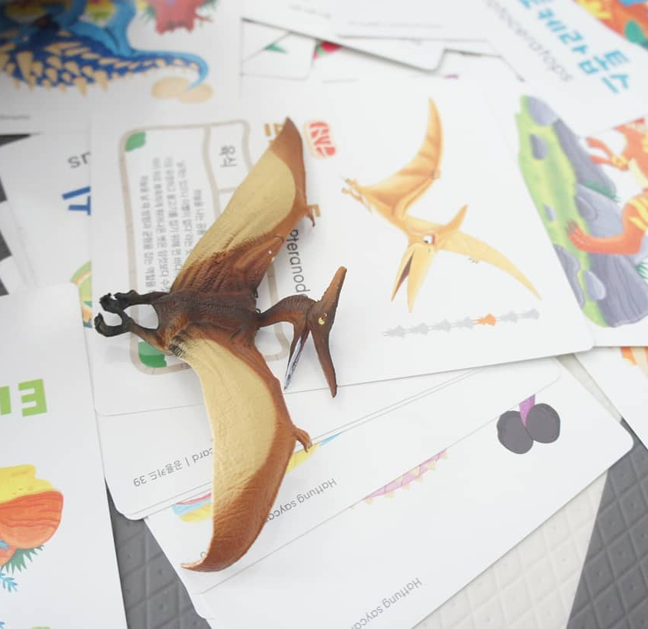
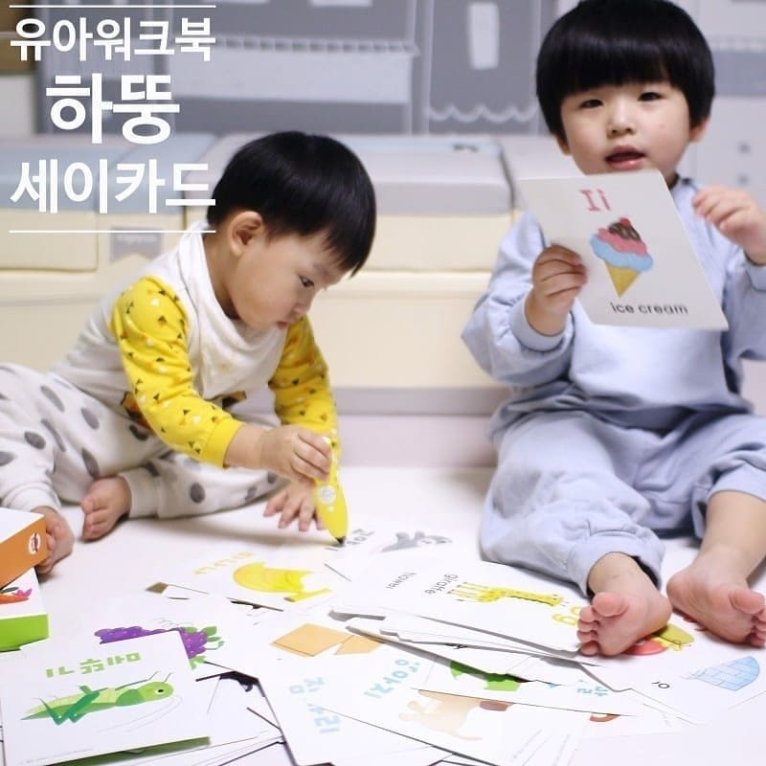
Background
Online + Offline
We think that Three-dimensional English card could be fun!
Many children still learn Alphabet and English words with plastic alphabet cards.
So, we made “ARpopUP”

Slide 4
Introduction
Vocabulary Learning App using AR
This Application “ARpopUP” is for helping children to study English alphabet.
Kids can learn vocabulary easily and interestingly with this Application.
Proposal of active learning direction of Alphabet card learning

Slide 5



Implementation
Platform
AR function was implemented using A and B and basically application for tablet was made using C.
Image marker by using Vuforia
Marker and 3D model interaction by Unity
Basic application format and work by Android Studio

Slide 6

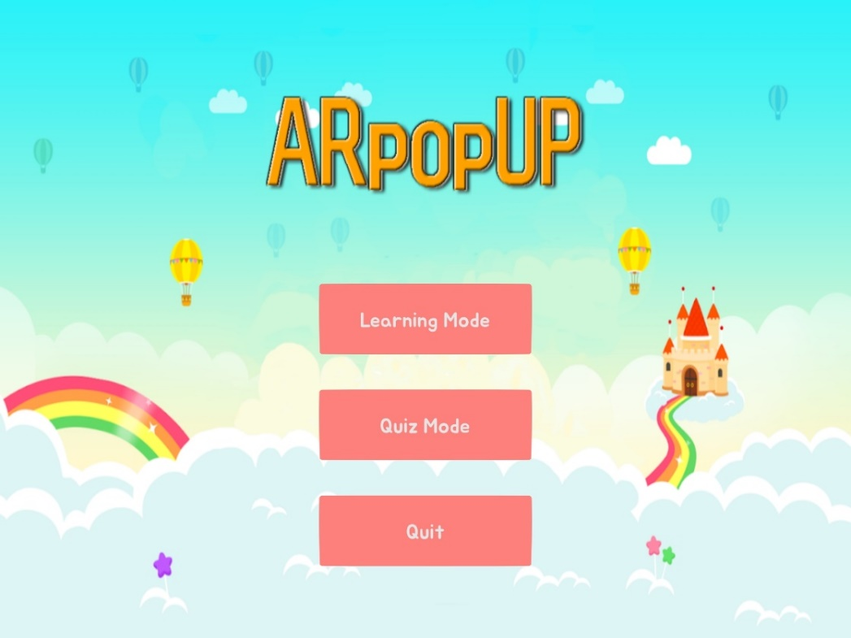
Implementation
<< Main screen >>
Click the button to select a learning mode or a quiz mode.
Bright and fairy-tale mood

Slide 7
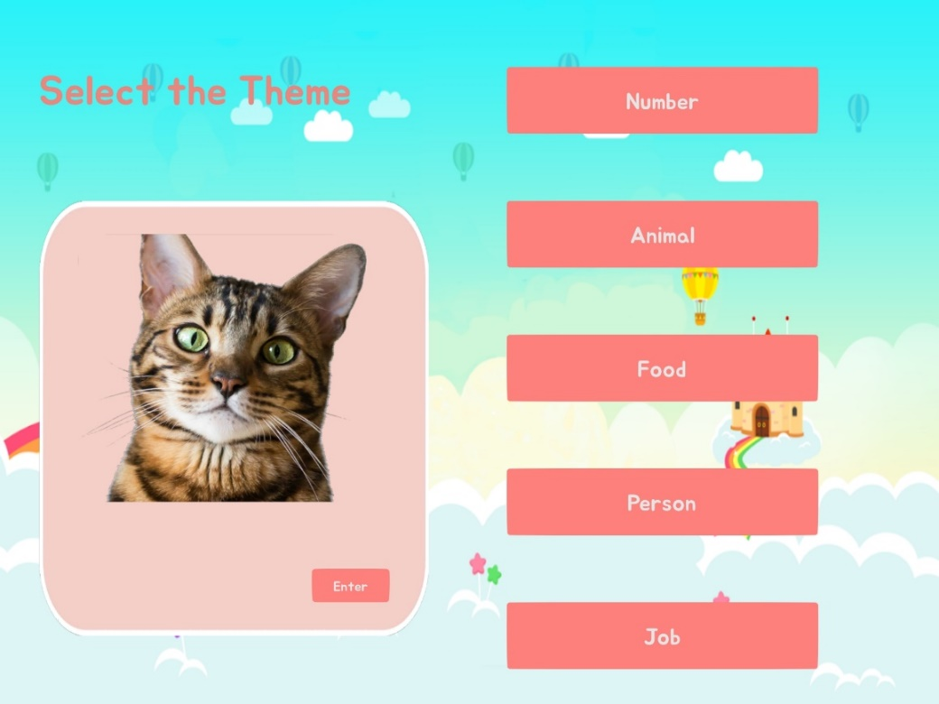
Implementation
<< Theme select >>
There are 5 kinds of vocabulary themes.
Number/Animal/Food/Person/Job
When you click the button, the preview image of the selected theme will show up.
The picture is an example of Animal theme.

Slide 8
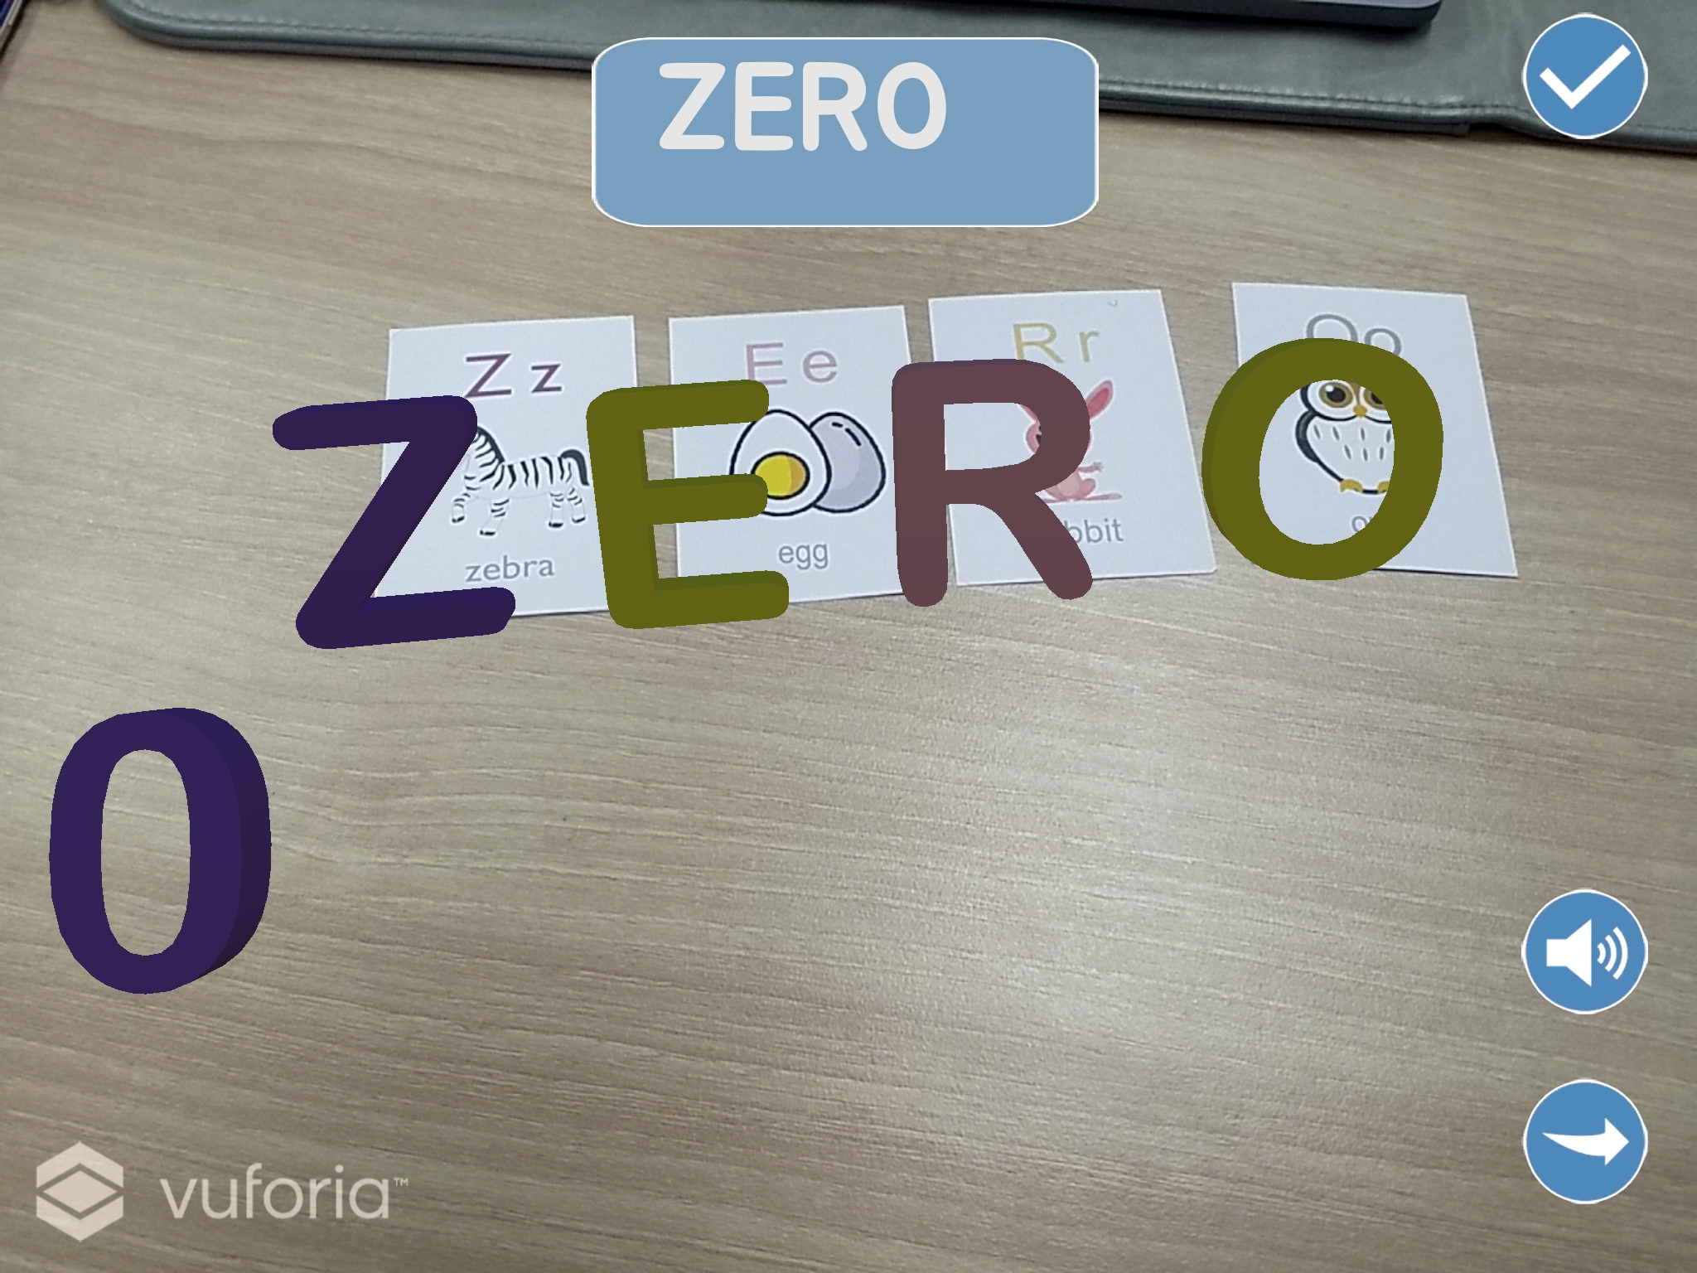
Implementation
<< Learning mode >>
Children can learn how to spell the word through the screen.
Possible to hear the pronounce and watching 3D model.
Kids can play with the card and 3D model as much as they want
Kids can go to the next word by clicking next button

Slide 9
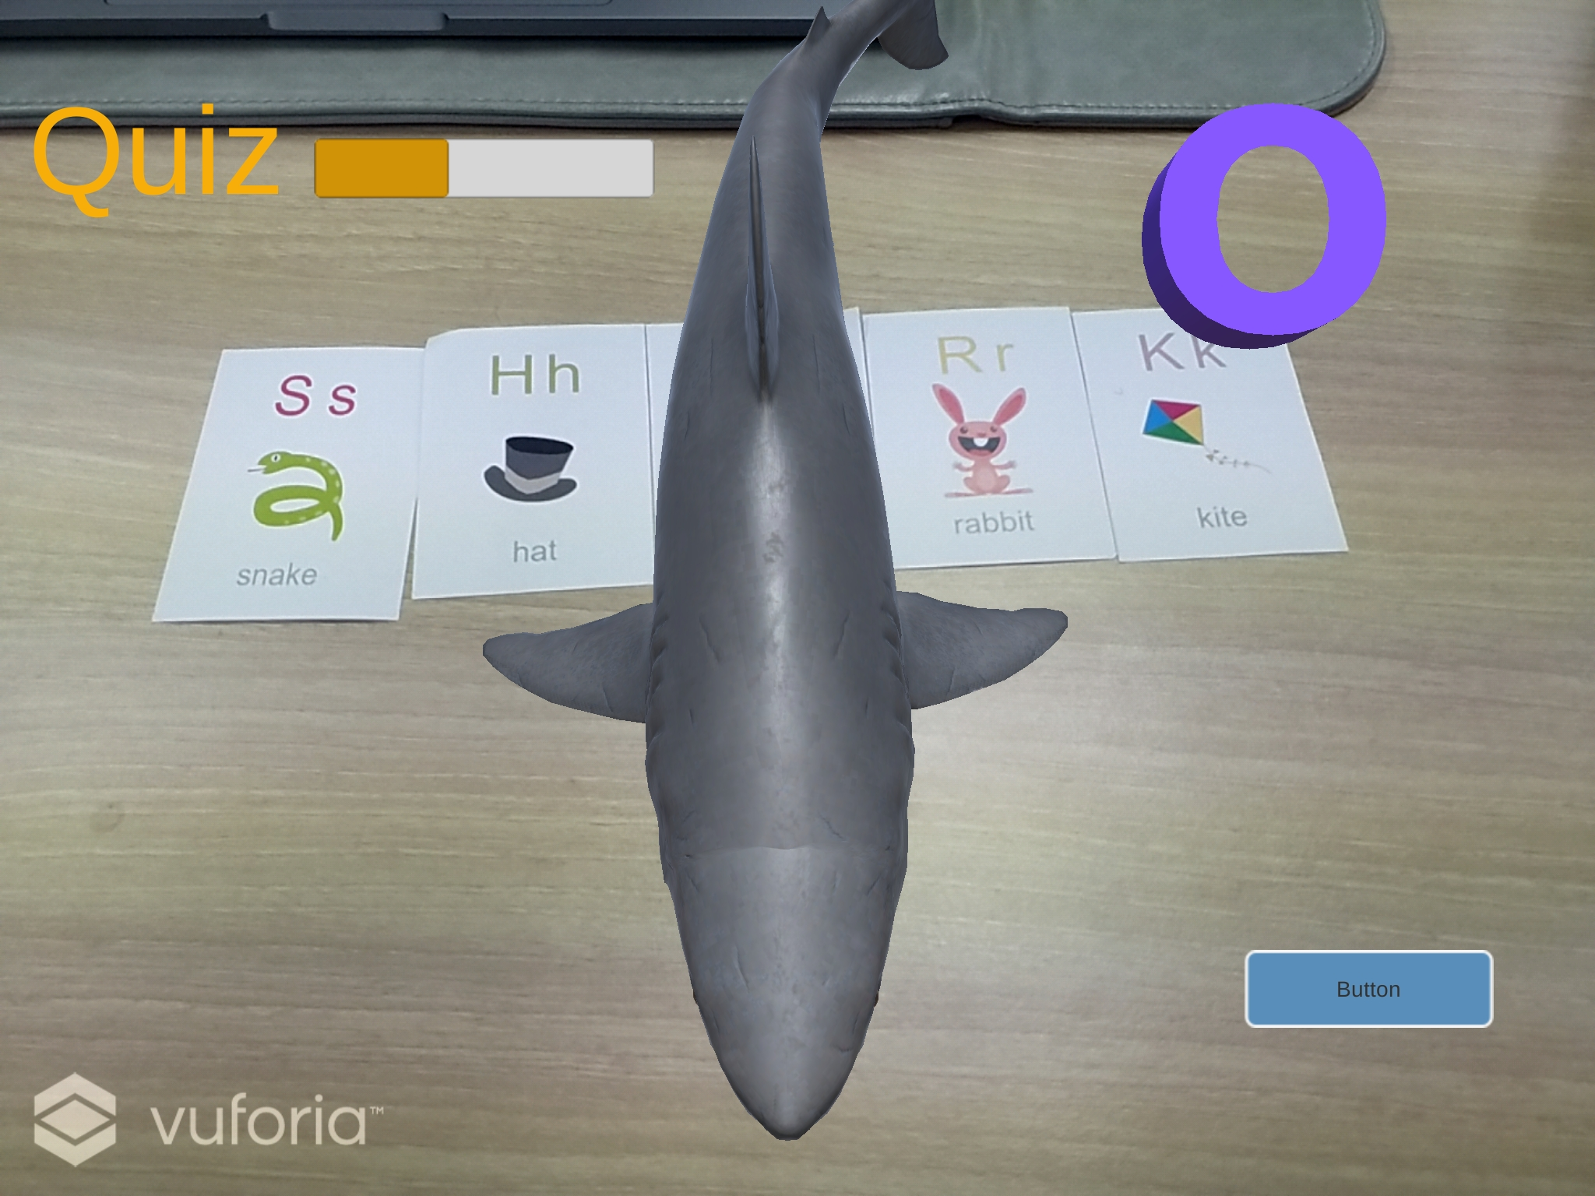
Implementation
<< Quiz mode >>
In this section, kids can take a quiz of what they learn from learning mode.
The problem is randomly presented and the images and sounds of the word are told.
There is no time limit, but if wrong, we move on to the next question.
The quiz ends when all the gauges are filled.

Slide 10

Implementation
<< Score >>
Show the score of the Quiz.
Give 10 points to a question.
Each stage has 10 questions.

Slide 11







Implementation
Implementation Process
Comparing SDK (ARcore vs Vuforia)
Research
(Unity, C#, Vuforia)
Marker Tracking I
(Alphabet)
Marker Tracking II
(Object)
Develop
Learning mode
Develop Quiz mode
Develop
Game mode

Slide 12

Key Features
The kids will enjoy of learning English alphabet and vocabulary with the colorful and lovely 3D AR animations
2. Parents don’t need to buy anything else just downloading “ARpopUP” (without equipment for exclusive use)
3. Kids can arrange cards directly to match words. And to check learning ability through quiz mode.

Slide 13
Marketing plan
Strength
-Low cost of use, Just App & Cards
-New way of learning Words
Weakness
-Lack of 3D model content
-Need space to put the card to play
Opportunity
-Increasing interest of AR industry
-Increased child tablet PC usage
Threat
-Side effects on the use of AR for infants and children
-Diversified Children's Toys and Apps

Slide 14
Marketing plan
Strength
-Low cost of use, Just App & Cards
-New way of learning Words

Slide 15
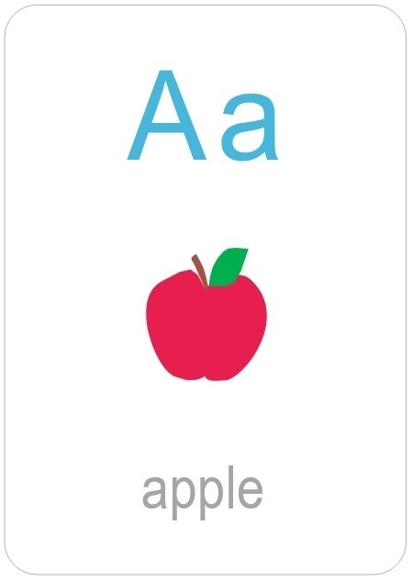
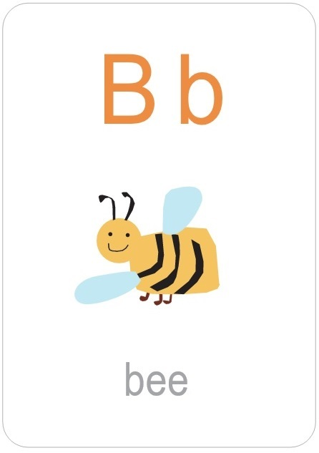
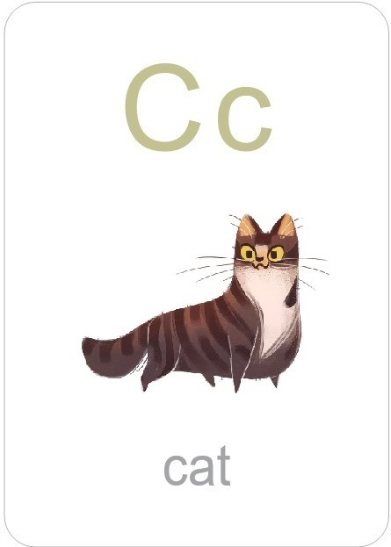
Marketing plan
Strength
-Low cost of use, Just App & Cards
Not particular materials!
just print the card and
download application

Slide 16
Marketing plan
Strength
-New way of learning Words
There are no applications in the market today
that combine alphabets to create words
and modeling in augmented reality.

Slide 17
Marketing plan
Weakness
-Lack of 3D model content
-Need space to put the card to play

Slide 18
Marketing plan
Weakness
-Lack of 3D model content
We now have a total of three models (numbers, animals, food)
It is difficult for developers to make 3D objects directly
It is economically limited to buy objects from the store.

Slide 19
Marketing plan
Weakness
-Need space to put the card to play
There is a high dependence on the recognition rate of the Vuforia that we use today.
Therefore a white background such as white board is required to increase the recognition rate.

Slide 20
Marketing plan
Opportunity
-Increasing interest of AR industry
-Increased child tablet PC usage

Slide 21
Marketing plan
Opportunity
-Increasing interest of AR industry
Expected to grow by $ 120 billion in 2020.
AR market size to be
ahead of VR market after 2019

Slide 22
Marketing plan
Opportunity
-Increasing interest of AR industry
Various applications of AR technology
Promotion of AR contents development
in some university education and industrial sites
Consumer needs
- educational contents development using AR

Slide 23
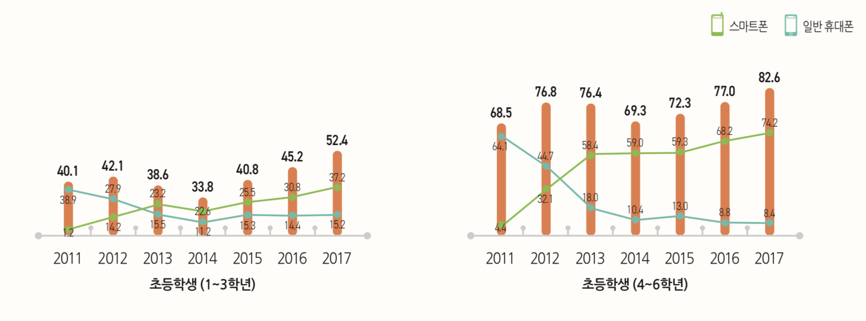
Marketing plan
Opportunity
-Increased child tablet PC usage
Increased tablet PC usage
by elementary school students
Source : KISDI STAT REPORT – 2018.12.15

Slide 24
Marketing plan
Threat
-Side effects on the use of AR for infants and children
-Diversified Children's Toys and Apps

Slide 25



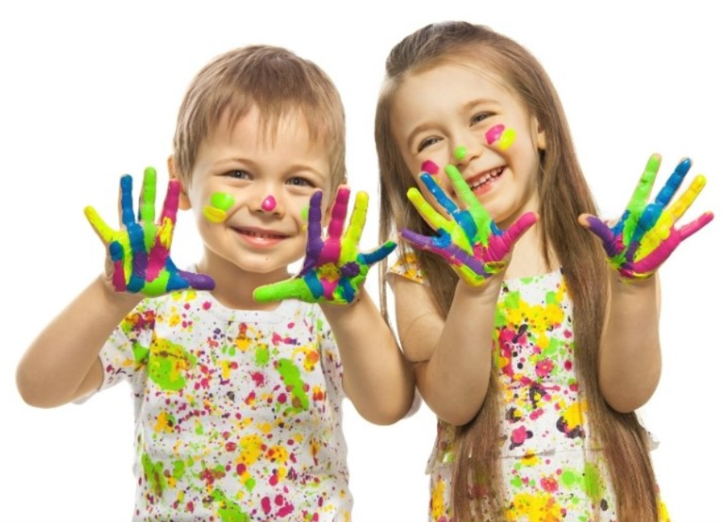
Marketing plan
Segmentation & targeting
For 5-7 ages

Slide 26
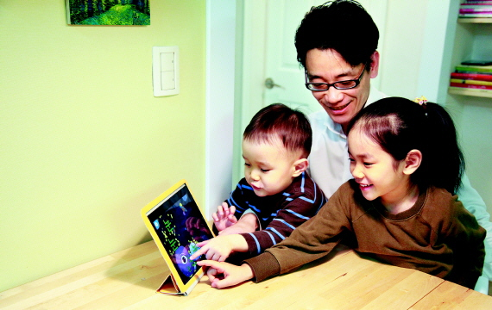
Marketing plan
Positioning
It's not about learning,
it's about playing!
A
C
B
E

Slide 27
Thank You

